Slide 1
Nasonex® Direct-to-Consumer TV Advertising:
Sales Impact & Return-on-Investment Evaluation
Promotion Response Analytics
Commercial Analytics
US Commercial Operations
January 23rd, 2012

Slide 2
Background
The objective of this project is to estimate sales impact and return-on-investment for Nasonex® direct-to-consumer television advertising using marketing mix modeling.
This project is part of a work stream requested by the Merck U.S. leadership team to inform 2012 investment allocation decisions for Nasonex®
  This is an update for Nasonex® as marketing mix modeling was performed for this brand in 2010.
This analysis will help to inform investment levels for TV advertising for Nasonex® in 1S2012 and 2S2012.
  To be leveraged appropriately for making resource allocation decisions, these retrospective results need to be interpreted in the context of future potential patients, brand messages, competitive dynamics, market events, product life cycle, and other influences.

Slide 3
Executive Summary
This analysis estimates sales impact and ROI for investment in DTC TV advertising for Nasonex® based upon the historical time period of August 2009 through July 2011, leveraging Nielsen Gross Ratings Points while controlling for prior month sales, seasonality, concurrent Field promotion and other brand TV advertisements.
Impact of Nasonex® TV Ads:
  Per GRP, Ads during second half of the year are more impactful than the first half of the year.
  The sales impact of GRPs during January 2011 through July 2011 was not statistically different from the sales impact of GRPs during first half of 2010.
Incremental Revenue:
  Nasonex® DTC TV advertising during the analysis period is estimated to contribute approximately $225 MM to before-tax total sales.
Program Cost:
  Before-tax cost of the campaign during the analysis period of 24 months is $84.4 MM.
ROI:
  The campaign results in a ROI of 2.7:1, indicating that approximately $2.7 of revenue was earned for every dollar invested in Nasonex® TV advertising.

Slide 4
Approach
This analysis studies the impact of Nasonex® TV advertisements on NRx volume.
The analysis period is from August 2009 to July 2011 (24 months). The target population for the Nasonex TV advertisements are adults aged between 21 to 54 years.
Monthly Rx and promotional data aggregated at the DMA level were used in the analysis.
During the analysis period, the overall number of details for Nasonex® has changed. This analysis explicitly controls for such changes. It also controls for impacts due to other promotions such as samples and managed care influences.
Other events during the study period include Online campaigns, Vouchers and Coupon programs, the growth of generic Fluticasone and its impact to Nasonex NRx, Fluticasone shortages during April and May of 2010 and the launch of Allegra OTC in March of 2011. These events were also indirectly controlled.
Effects of TV DTC campaigns by other products like Omnaris and the OTC products Allegra, Zyrtec and Claritin were also controlled. In particular, Allegra has greatly increased its TV Ads from March of 2011.

Slide 5
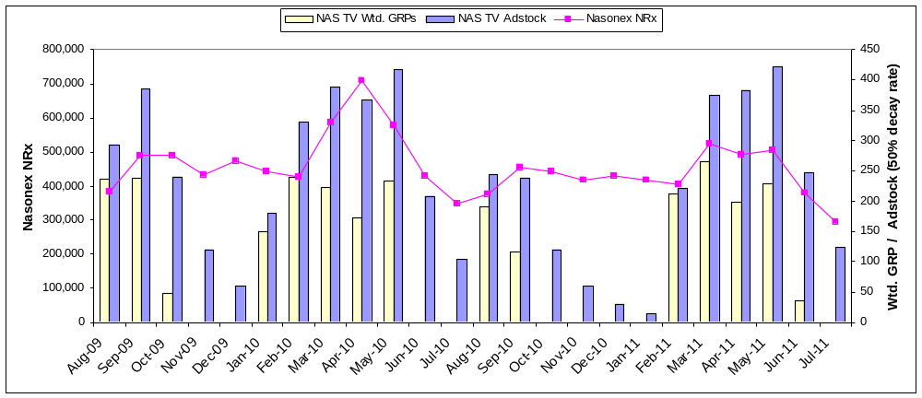
Analytical Time Period
The analytical period assessed in this analysis is August 2009 through July 2011. GRPs for the target population are weighted to 60 second durations and transformed to adstock to capture the lagged effects of TV on NRx volume. The NRx and GRPs vary similarly with peaks during seasonal months. From 2010, the weighted GRPs are reduced when compared to previous levels.
Study Period Starts here
Fall Seasonal Months.
Primary Allergy Season.
Allegra OTC launched in March 2011. Allegra OTC greatly increased TV Ads. From March 2011.
Study Period Ends here
Primary Allergy Season.
Fluticasone Shortage in April and May 2010
Fall Seasonal Months.
GRPs are for Adults aged between 21 to 54 years (Target Population).
Study Period: Aug-2009 to Jul-2011

Slide 6
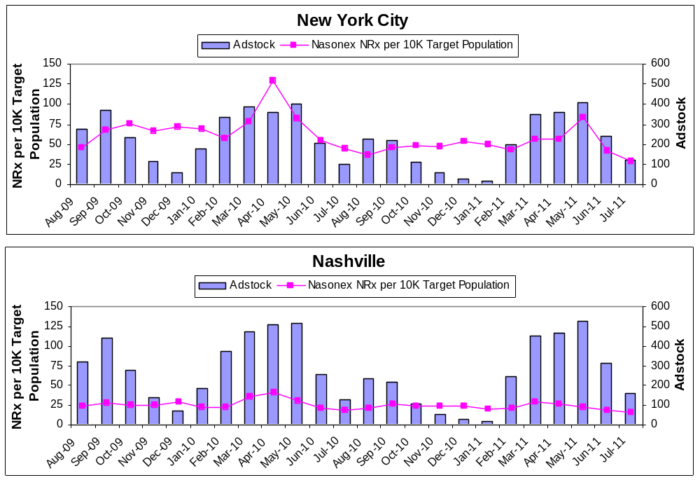
Visualization of Method
The effect of DTC TV advertising on sales is evaluated using 208 time series* like these as input, all assessed simultaneously to estimate increase in NRx corresponding to increase in GRP adstock while controlling for baseline scriptwriting, other promotions, managed care influences, seasonality and market events.
In April 2010, Nasonex® had 360 GRP Adstock of exposure in NYC and 507 Adstock of exposure in Nashville. Such differences in exposure across DMAs are leveraged in the modeling process to quantify corresponding differences in sales volume.
In Nashville, exposure of the branded campaign ranged from 14 to over 528 in terms of GRP Adstock. Such differences in exposure across time are leveraged in the modeling process, exploiting the peaks and valleys in exposure to look for corresponding peaks and valleys in volume.
* There are 210 DMA’s in the Nation. Two DMA’s with low target population were removed as they were outliers.

Slide 7








Modeling Process Summary
Time-series cross sectional regression models estimate incremental monthly-DMA level NRx volume due to brand TV advertising while controlling for prior NRx volume, field promotion, managed care access, market events, and competitive advertising.
Product NRx
DMA Population
Nasonex
GRP Adstock
Competitors
GRP Adstock
Concurrent
Promotions
# of Prescribers
Pre-period
Product NRxs
DMA Population
Managed Care
Access (%)
Variables for Each Month for Seasonality and Market Events
# of potential
=
+
+
+
+
+
Nasonex NRx for a given month within a DMA per 10K adults in 21-54 age group in the DMA is calculated to “population normalize” scripts, effectively putting DMA-month level prescription volume on a common scale across DMAs.
Adstocks created from Nasonex GRPs are already on a common reach-like scale.
Nasonex Adstocks were modeled using two interaction terms based on first and second half of the year. This was done to study the differential impacts of first and second semesters of a given year.
Other promotional variables (details, samples) per 1,000 prescribers in the DMA are computed to normalize the promotional variables across DMAs.
Carryover script writing regardless of promotions (brand equity) is accounted by including normalized pre-period Nasonex NRx.
Non-Restricted formulary access (expressed as %) for Nasonex is used to control for Managed Care influences.
Variables for each month were introduced to control for seasonality and market events such as effects of generic Fluticasone growth on Nasonex NRx, Fluticasone supply issues, Allegra OTC launch etc. These variables also provide overall control for other online promotions, vouchers, coupons and other unknown influences across time to the extent they could be captured.
Omnaris and OTC TV ad exposures were explicitly controlled. OTC products here include Allegra, Zyrtec and Claritin as one bucket. These three OTC brands had a large voice in terms of TV Ads. After Allegra OTC launch in Feb/2011, its TV Ads had increased substantially, and this is captured by combined OTC TV GRP bucket.
A Random Intercept model was constructed to further account for unobserved DMA specific effects.
The output is the average incremental NRx volume per month per 10K target population.

Slide 8
Technical Notes
The model used in the analysis uses linear interaction terms for Nasonex Adstock. Nasonex Adstock were split into two based on first half (Semester 1) and second half (Semester 2) of the year. This kind of data split was done to tease out the performances during first and second half of the years as the Ad patterns and their impacts were observed to be different.
To accommodate the study period well, 2009 Semester 2 was considered from Aug-2009 to Dec-2009 (5 months) and 2011 Semester 1 was considered from Jan-2011 to Jul-2011 (7 months). In 2010, each semester had 6 months of data.
A quadratic term and higher order terms did not yield significant estimates, suggesting that in the experience range of Nasonex TV Adstock during the study period, the relationship between Adstock and sales appears to be linear and does not contain saturation.
Non-parametric and semi-parametric methods were used to study the functional form of impact. This study suggests that the impact is approximately linear in the experience range. In addition, they confirm the differential impacts across Semester 1 and Semester 2.

Slide 9
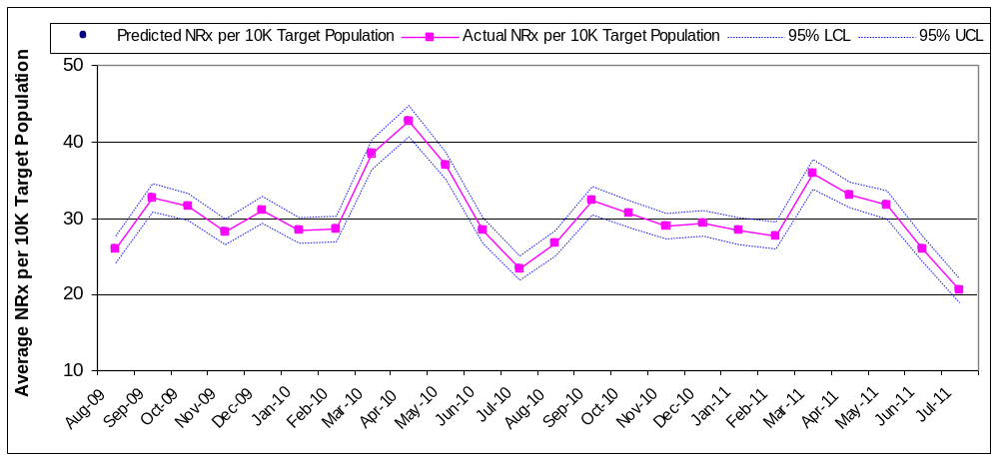
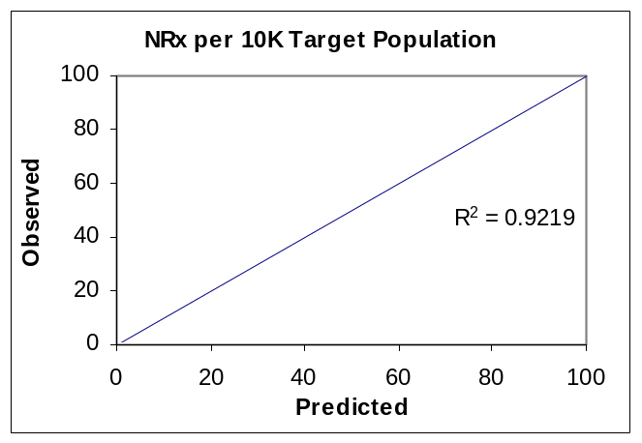
High Predictive Accuracy
Close correspondence of observed NRx volume to NRx volume predicted by the GRP-based model provides evidence of the robustness of the analytical results. The predictive accuracy of this model is similar to that achieved by prior analysis for other Merck brands.
Predicted values capture 92% of the variability in the observed monthly NRx per 10K target population.
Because of the model structure used here, the mean predicted and actual mean NRx values across time matches almost exactly.
Study Period: Aug-2009 to Jul-2011

Slide 10
Model Findings
Impact of various drivers of NRx volume agrees directionally well with the expectations. Total Nasonex TV DTC activities account for approximately 14.5% of Nasonex NRx during the study period. OTC TV DTC has negative impact on Nasonex NRx volume.
Drivers | Impact on Nasonex NRx | Statistical Significant? | Annual % Contribution towards Nasonex NRx (approx.)
Details | Positive | Yes | + 5.2%*
Samples | Positive | Yes | + 9.5%*
Managed Care Influences [% Non-Restricted] | Positive | Yes
Nasonex® TV DTC During 1st Semester | Positive | Yes | + 6%
Nasonex® TV DTC During 2nd Semester | Positive | Yes | + 8.5%
Omnaris® TV DTC | Positive | No
OTC TV DTC: Allegra® + Claritin® + Zyrtec® | Negative | Yes | - 7%
Lagged NRx (brand equity) | Positive | Yes
Contribution from Nasonex TV DTC campaign is approximately similar to contributions from Details and Samples taken together.
* Approximate values from separate physician level model (PRA) are represented here. Current model detail and sample estimates tend to have aggregation bias. Hence values from the PRA models were used here.
Study Period: Aug-2009 to Jul-2011

Slide 11
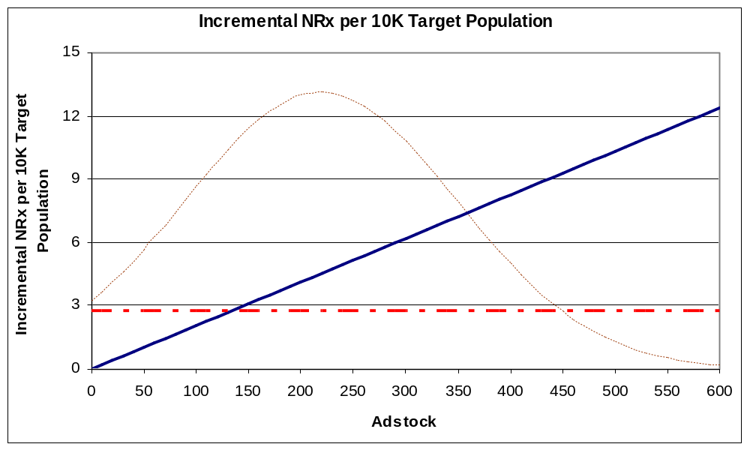
Impact on NRx
The statistical modeling process used in this analysis results in a linear response as shown below. Point of diminishing returns was not discernable in the experience range. The estimates have a greater degree of confidence around the average monthly adstock of about 218.
The dotted maroon line shows the frequency of observations used in the model.
  Observations are concentrated around the mean adstock value of about 218 per month.
  Greater degree of confidence in the estimates within the adstock range of 120 to 320 than outside it.
The dotted horizontal line refers to loss of Nasonex NRx due to OTC TV DTC activities during the study period.
  Around 64% of Nasonex TV Adstock [140] helps to just negate the impact of OTC TV Ads
Average Monthly Adstock During Analysis Period is 218
Study Period: Aug-2009 to Jul-2011

Slide 12





Nasonex DTC TV ROI
- August 2009 to July 2011
The GRP-based analysis shows that investments in Nasonex® TV campaigns resulted in a ROI of ≈ $2.7 : $1 based on branded campaigns between August 2009 through July 2011.
Before-Tax
The GRP-based analysis model was used to estimate the impact of TV ad exposure on sales during the analysis time period. The pre-tax 3-year NPV of a new patient ($144) was used to estimate the revenue.
➔
➔
➔
÷
GRP Cost was about $79.5 MM. An extra 6% was added to the GRP cost to account for other media costs like agency fees, talent cost and creative production costs.
This is the incremental revenue of the campaign divided by media, agency and production costs. This result indicates that $2.7 of pre-tax revenue was returned for each pre-tax dollar invested in TV.
  The 95% confidence interval of ROI is (1.6 : 1 to 3.7 : 1)
  A confidence interval is an interval in which a measurement or trial falls corresponding to a given probability. In this case, we are 95% sure that the true ROI lies between 1.6 to 1 and 3.7 to 1.
  An increase of 3% in TV DTC costs results in the ROI to decrease approximately by 0.1
Study Period: Aug-2009 to Jul-2011

Slide 13
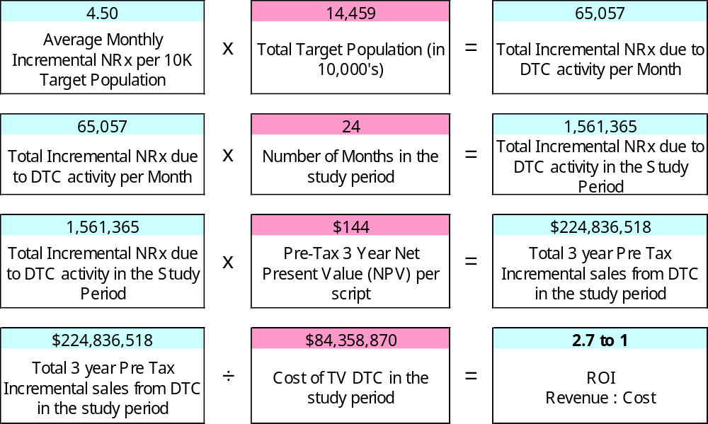
ROI Calculation – Before-Tax
This is a more detailed calculation of ROI. Merck’s financial models for revenue evaluations consider 3 year sales from new patients acquired by TV Ads.
GRP Cost was about $79.5 MM. An extra 6% was added to the GRP cost to account for other media costs like agency fees, talent cost and creative production costs. This results in total study period TV DTC costs to be about $84.4MM
Study Period: Aug-2009 to Jul-2011

Slide 14
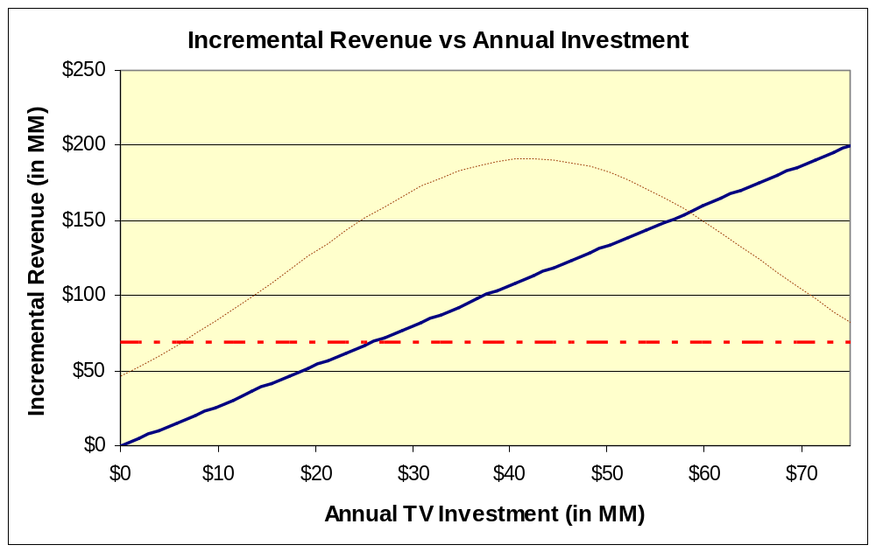
Incremental Revenue by Total pre-tax Investment
This incremental revenue vs. pre-tax annual DTC TV spend chart shows a revenue of about $112MM for the average pre-tax annual TV DTC spend of about $42MM. The estimates have higher confidence in the narrow range around the mean annual spend.
Historical annual TV investment
Dotted red line represents the incremental revenue lost to OTC TV Ads.
The modeled curve is linear, implying that as DTC spend increases, the revenue also increases proportionately. Further non-parametric studies suggests that within the data experience range, the saturation effect could not be observed.
The dotted red line shows the revenue loss due to OTC TV Ads during the year. About $26 MM of Annual TV investment is required to negate the impact of OTC TV Ads on Nasonex NRx. In addition, after Allegra OTC launch in March 2011, the TV spend for Allegra OTC has increased drastically, hence moving forward, a higher negative impact of OTC TV ads may be observed.
Study Period: Aug-2009 to Jul-2011

Slide 15
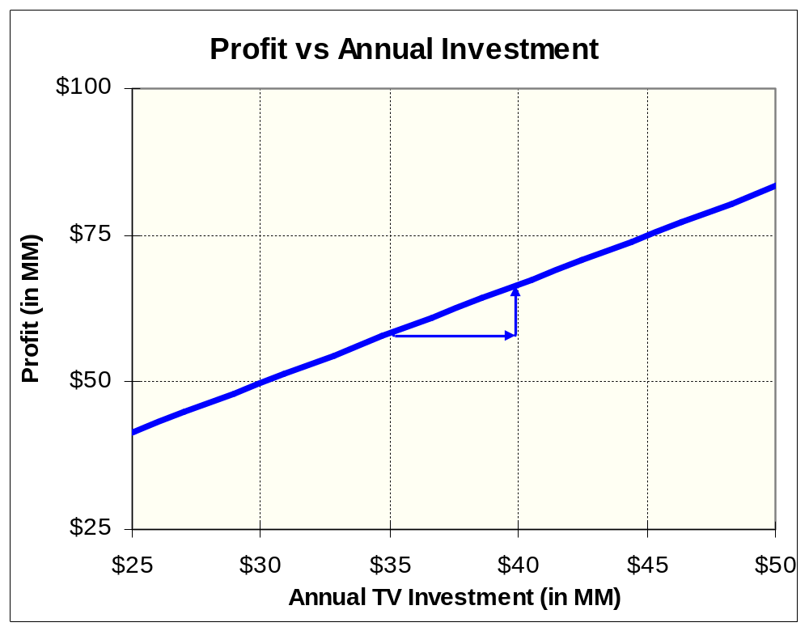
Profit by Total pre-tax Investment
Increasing the spend by $5MM yields about $10MM in profit.
Historical pre-tax TV investment of about $42MM results in estimated before-tax profit of about $71MM
Since the number of observations in the modeling process reduces drastically as we move away from the average annual spend, we are more confident in the predictive accuracy around the average annual spend than away from it.
It is assumed that as spend increases, the GRPs increases proportionately.
Study Period: Aug-2009 to Jul-2011

Slide 16
DTC Responsiveness across Semesters

Slide 17
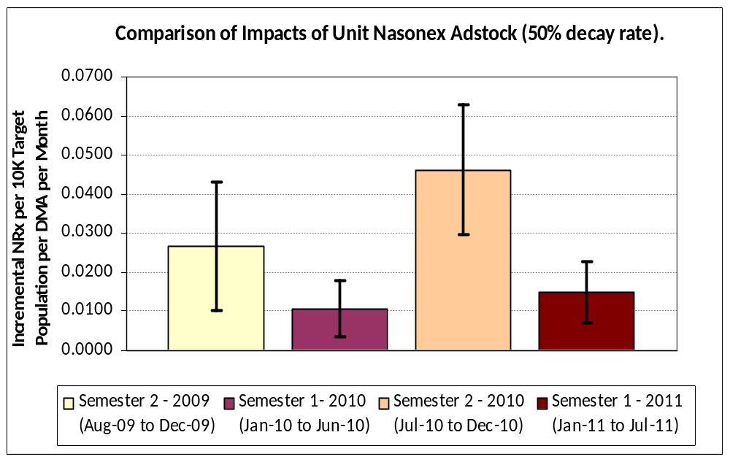
TV Campaign Impacts across Semesters in the study period.
Per :60 second GRP Adstock, First half of 2011 was as effective as that of 2010. Also, per Adstock, Semester 2’s are more responsive than Semester 1.
Second half of the years (Semester 2’s) are more responsive per GRP Adstock than First half of the years (Semester 1’s).
First half of 2011 is as responsive (per wtd GRP Adstock) as Semester 1 of 2010 as their confidence intervals overlap.
In terms of number of ad seconds the reach was similar between first semesters of 2010 and 2011. That is, though in 2011, :45 Second ads had a less raw GRP’s, their :60 Second weighted GRPs were similar to 2010.
Hence, :45 second ads had a higher impact but on standardized per :60 second GRP basis their impact is similar to that of 2010 Semester 1.
Mean estimate for 2011 is slightly higher than 2010 (not statistically different though). In 2011, the ads started airing in February and in 2010 it started in January. Starting the Ads in February might be a better strategy.
This represents 95% confidence Interval. For first half of the year, both 2010 and 2011 estimates overlaps, suggesting that they are not different statistically.
Semester level estimates here were obtained from supporting models. They are more appropriate in making relative comparisons.
Study Period: Aug-2009 to Jul-2011

Slide 18
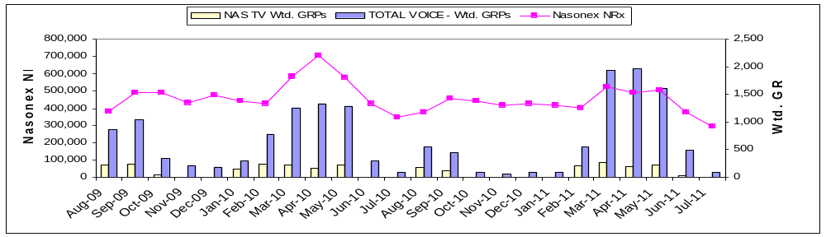
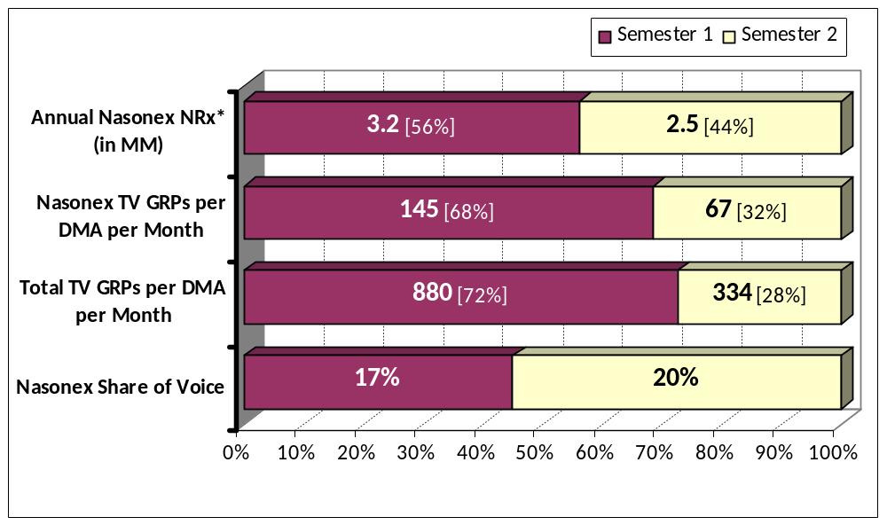
TV Campaign Trends: First and Second Semesters
Total TV Voice in Semester 2 is much lower than Semester 1. Nasonex share of voice is slightly higher in Semester 2 than in Semester 1.
S2
S1
S2
S1
Nasonex NRx in first half of 2010 is about 56% of total NRx in 2010.
Semester 1 Nasonex TV GRP is about 68% of yearly GRPs. This % is higher when compared to NRx split.
Total voice in Semester 2 (334 GRPs) is much lower than in Semester 1 (880 GRPs).
* Annual NRx in the chart is based on year 2010. All other metrics are study period averages per DMA per Month
Study Period: Aug-2009 to Jul-2011

Slide 19
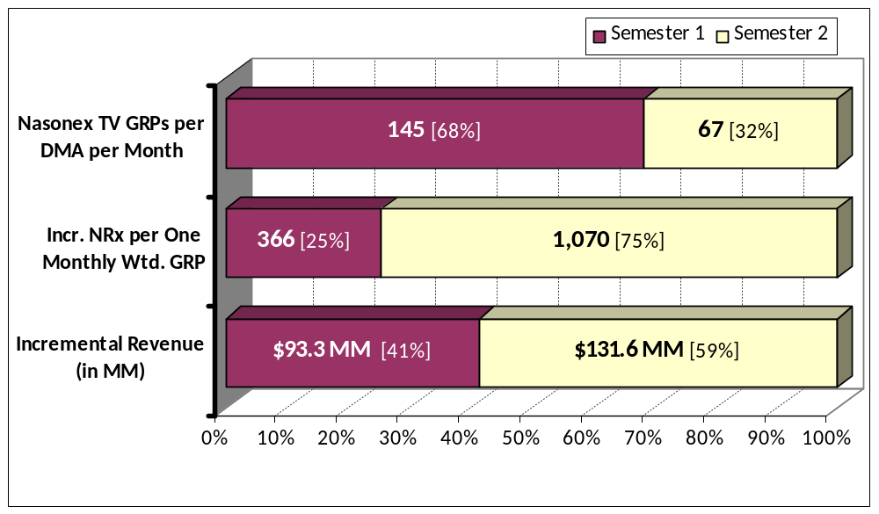
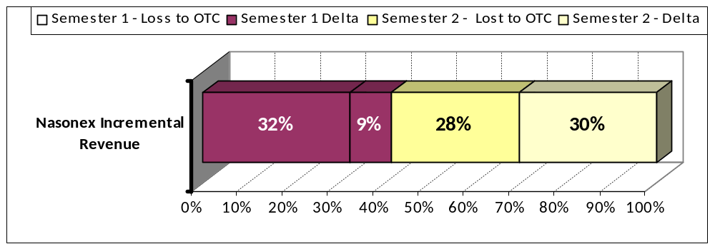
Nasonex TV Campaign Impacts: First and Second Semesters
Per GRP, Semester 2 impacts are much larger than in Semester 1. Semester 2 contributes about 59% of total 3 year pre-tax revenue generated. Semester 1 Ads are mostly spent in negating the effects of OTC Ads.
Nasonex GRPs in Semester 1 is higher than that in Semester 2.
However, Semester 2 impact per GRP Adstock [75%] is much higher than in Semester 1 [25%].
Because of this, 59% of Annual Incremental Revenue comes from Semester 2.
One theory that might explain this: During Semester 2 the total TV voice is low and any voice during this period yields a higher response.
OTC TV campaigns have a negative impact on Nasonex NRx.
  In Semester 1, most of the Nasonex TV campaign just goes to negate the effects of high OTC campaigns during these periods.
  In Semester 2, about half of the Nasonex campaign is spent on negating the effect of OTC campaigns during this period.
Since the launch of Allegra OTC in 2011, their TV campaigns have increased substantially and probably all the Nasonex Semester 1 campaign effects are negated by the OTC campaign.
One recommendation would be to hold the Semester 1 GRPs at current (or slightly higher) level and increase the Semester 2 GRPs by 10% or more to achieve a higher annual incremental revenue.
Study Period: Aug-2009 to Jul-2011

Slide 20
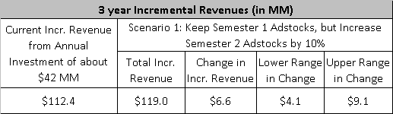
Incremental Revenue from a Scenario: Hold the Semester 1 Adstock level the same and increase the Semester 2 Adstocks by 10%.
In this scenario, a $6.6MM additional 3 year incremental pre-tax revenue may be achieved. A conservative estimate would be an additional revenue of about $4.1 MM.
Lower and Upper ranges are based on 95% Confidence Interval of the Mean Estimate.
Study Period: Aug-2009 to Jul-2011

Slide 21
Conclusion
This analysis suggest that investments in Nasonex® TV media, production, talent and agency fees were profitable during the studied time period (August 2009 through July 2011) with an approximate ROI of $2.7:$1.
The modeling approach suggests:
  that within the experience range the response is linear and does not show any saturation, and
  that an increase in media investment of approximately $5MM vs. historical investments may increase the profits from the investment by $10MM.
  Second half of the year is more impactful per Ad than the first half of the year.
  45 second Ads during first half of 2011 had a total impact that is not statistically different from that of 30 second Ads during 2009 – 2010 time frame of the study period. In terms of total Ad seconds, 2011 Ad activities were similar to 2010 activities during the same time period.
  By holding the current spend during first semester and increasing the second semester GRPs by 10%, an estimated additional incremental revenue of about $6.6MM may be possible (a more conservative estimate would be about $4.4MM).
This analysis is best used to inform relative investment decisions rather than as a measure of absolute ROI.

Slide 22
Fair Balance
General Comments
  The analytical methods applied here leverage naturally-occurring variability in sales, promotion and advertising over time and geography, and are useful for informing decisions regarding adjustment of DTC TV advertising expenditure within the range of current (analyzed) spending levels. Using these analyses to make inferences about return on investments far below or far above the level of investment analyzed here may be invalid.
  The present analytical results estimate retrospective ROI for DTC advertising for an 24-month historical time period. To be leveraged appropriately for making resource allocation decisions, these retrospective results need to be interpreted in the context of future potential patients, brand messages, competitive dynamics, market events, product life cycle, and other influences.

Slide 23
Fair Balance
Nasonex® Considerations
  This analysis examined the direct effects of TV without directly controlling for print and online ad exposure since print exposure tends to be highest when TV exposure is highest and vice versa. The print and online ad exposures were indirectly controlled at a high level using monthly intercepts. For these reasons, the sales impact of TV reported here is likely to include some of the impact of print and online media as well.

Slide 24
Appendix

Slide 25
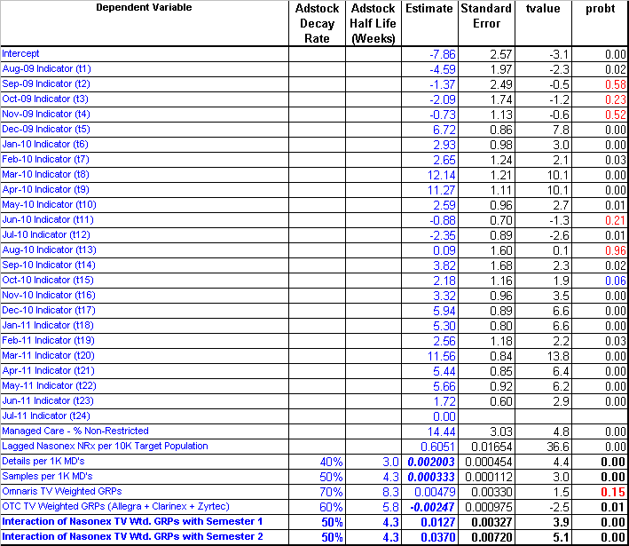
Model Estimates
Impact of various drivers of NRx volume agrees directionally well with expectations.
Study Period: Aug-2009 to Jul-2011

Slide 26
Technical Notes – Cont’d
Simulations were carried out to test the completeness of the model form, particularly the Nasonex GRP interaction terms.
Influence Diagnostics led to the removal of two outlier DMAs. These two DMAs had a very low population. In total, 208 DMAs and 24 months of data was used for modeling.
In this case, due to convergence issues, Random Intercept model was achieved indirectly by using spatial exponential repeated measures error covariance structure.
The Fixed Effects(FE) model structure that uses within subject variation alone, as proposed by Prof. Allison, leads to a less biased estimate than a Random Intercepts(RI) model used here. However, a lot of information is lost as between-subject variations are not used. A hybrid approach suggested by Prof. Allison could be used to test if each of the model parameter estimate is statistically different between FE vs. RI model and helps to interpret the biasness of each parameter estimate of RI model. For Nasonex GRP, using hybrid models, the estimates between FE and RI models were not found to be statistically different. Hence RI model yields a less biased estimates for Nasonex GRPs. Advantage of using RI model is on using some of between subject variations and achieving statistically significant (probably biased) and directionally relevant estimates for other promotions like details, samples etc., Hence, the final model was chosen to be a RI model.

Slide 27
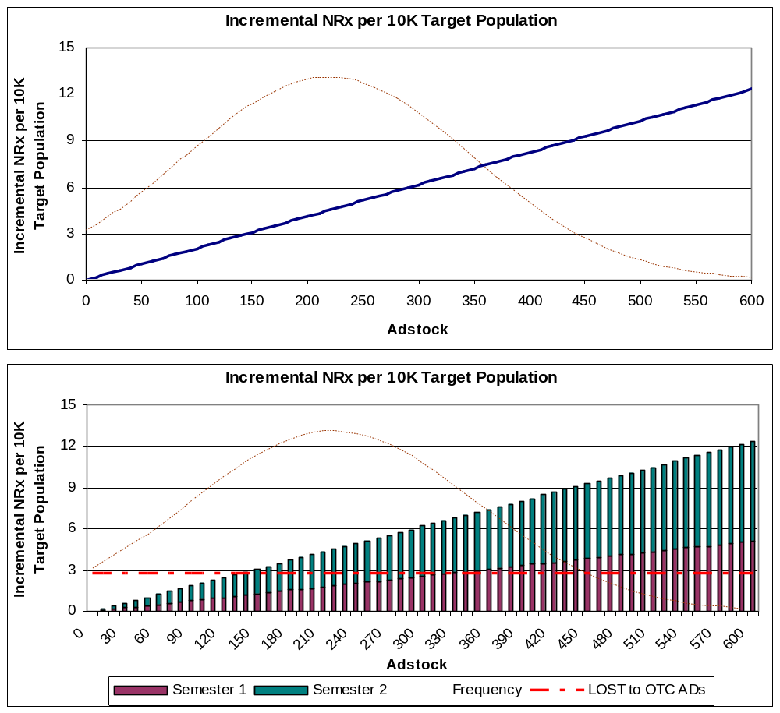
Impact on NRx
The statistical modeling process used in this analysis results in a linear response as shown below. Point of diminishing returns was not discernable in the experience range. The estimates have a greater degree of confidence around the average monthly adstock of about 218.
The dotted brown line shows the frequency of observations used in the model.
  Observations are concentrated around the mean adstock value of about 218 per month.
  Greater degree of confidence in the estimates within the adstock range of 120 to 320 than outside it.
The dotted brown red horizontal line refers to loss of Nasonex NRx due to OTC TV DTC activities during the study period.
  Around 64% of Nasonex TV Adstock [140] helps to just negate the impact of OTC TV Ads.
Semester 2 has a much higher impact per GRP than Semester 1.
Average Monthly Adstock During Analysis Period is 218
Study Period: Aug-2009 to Jul-2011

Slide 28
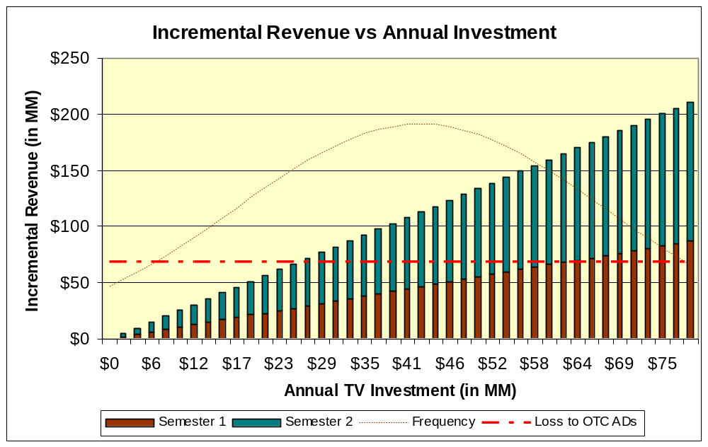
Incremental Revenue Contribution during first and second half of the year by Total pre-tax Investment
This incremental revenue shows a considerably large impact from second half of the year though the Adstocks are lower during these period. The total voice is also lower in Semester 2 and may be a contributing factor for higher sensitivity per GRP during Semester 2.
Historical annual TV investment
The dotted red line shows the revenue loss due to OTC TV Ads during the year. About $26 MM of Annual TV investment is required to negate the impact of OTC TV Ads on Nasonex NRx. In addition, after Allegra OTC launch in March 2011, the TV spend for Allegra OTC has increased drastically, hence moving forward, a higher negative impact of OTC TV ads may be observed.
Study Period: Aug-2009 to Jul-2011

Slide 29
Method Overview & Benefits
GRP-based analyses study large-sample response to TV ads & are standard throughout our industry.
Overview: GRP-based analyses leverage variability in audience exposure to TV ads across time and geographic areas to provide a robust estimate of the effect of these ads on sales.
  Variability in GRPs/DTC advertising pressure occurs…
    across time because of variable flighting patterns and viewing habits, and
    across geographies because of differences in regional audience composition, viewing habits and local “spot” TV where applicable.
  Time-series cross-sectional statistical regression models are used to estimate the independent incremental impact of TV ads on NRx sales while controlling for baseline scriptwriting, concurrent field sales promotion, seasonality, and market events.
Benefits: Assessment of DTC advertising sales impact and ROI using GRP-based analysis can be executed in-house at a low cost, and allows benchmarking against other pharmaceutical brands.
  Extensive evaluation of available approaches was done to identify this best-practice approach (e.g., vendor capabilities assessments and review of academic and industry literature).
  This is a standard method in the pharmaceutical industry and for consumer packaged goods.

Slide 30
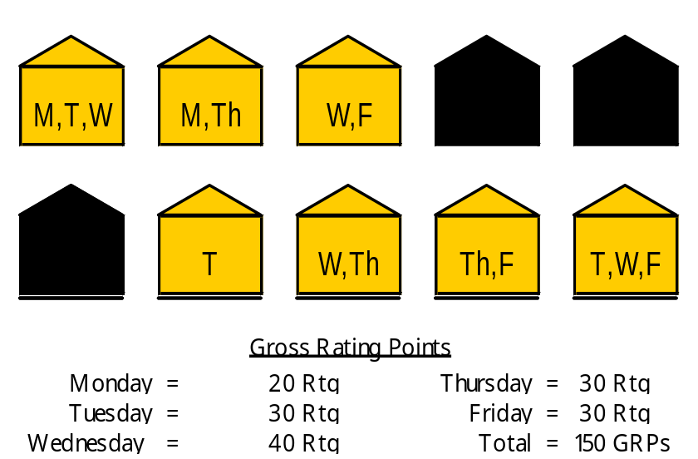
Gross Rating Points
GRPs provide a standard measure of exposure to a DTC advertising campaign based on TV viewing.
Definitions
  Rating: percentage of TV households tuned into an episode of a particular program
  Gross Rating Points (GRPs): sum of all ratings during a specific time period
  Following is an illustration of Ratings and GRPs for an exemplary universe of ten TV households over a five day period measuring a program airing Monday through Friday:
  Described another way, GRPs represent the gross duplicated percentage of households reached by a particular campaign (reach * average frequency).
This is an example of daily ratings for a program airing once each weekday, summarized into GRPs for a one-week time period. GRPs for a particular campaign are computed by adding the ratings for all of the individual programs during which the commercial(s) aired over the time period of interest.

Slide 31
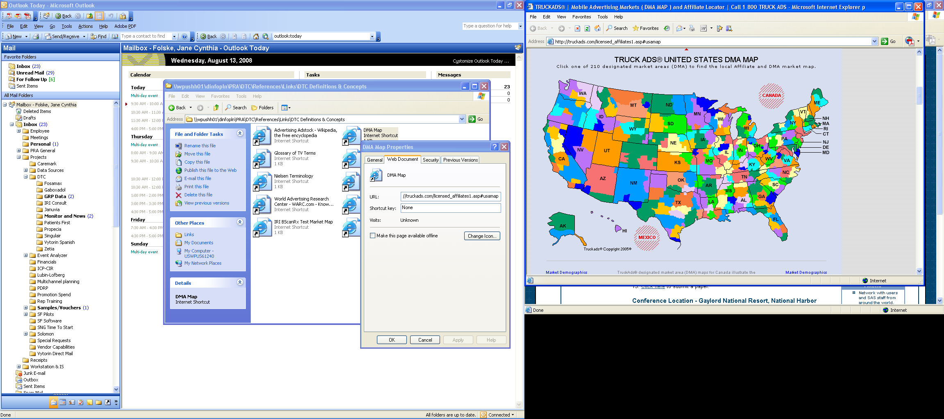
Regional Ad Exposure
GRPs are available by DMA to capture regional differences in TV viewing habits & ad exposure.
Description
  Weekly GRPs are available by creative execution for each of the 210 local Designated Market Areas (DMAs).
  Local Nielsen ratings are projected from a large sample of TV households across the US, selected randomly to insure unbiased estimation of national viewing habits (e.g., the New York sample alone consists of 828 households).
  Merck purchases data for the top 100 DMAs which characterize approximately 65% of the US population.

Slide 32
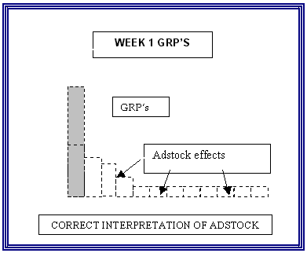
Data Transformations
Lagged effects (carryover) of DTC ads & other forms of promotion are included using adstock.
The adstock transformation is based upon prior research and has been adopted as standard practice for GRP-based analysis and other marketing mix modeling processes.
  For example, the effects of current GRPs
  in future weeks are captured by adding a
  portion of Week 1 GRPs to GRPs in
  Weeks 2, 3, and beyond. The portion
  of GRPs to be carried forward is
  estimated during the modeling process.
http://www.ephrononmedia.com/article_archive/articleViewerPublic.asp?articleID=97

Slide 33
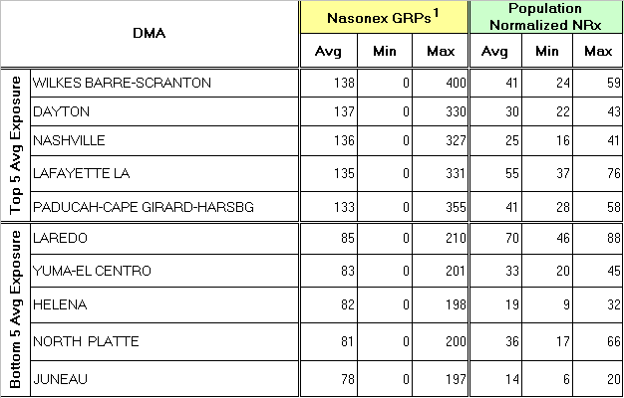
Nasonex® TV Case Study
GRPs varied from 0 to 400 across DMAs and months between August 2009 and July 2011, providing more than adequate variability to study the impact of the TV campaign.
Average monthly Nasonex ad exposure varies considerably across DMAs and ranges widely from no expsure to high levels of exposure.
Study Period: Aug-2009 to Jul-2011
1. Raw GRPs have been equivalized to a 60 second duration, so that reported GRPs for 30 second ads are halved, and reported GRPs for 45 second ads are reduced by 75%..

Slide 34
Notes Regarding Reach and Frequency
Planned reach and frequency are functions of existing awareness, seasonality, population size and complexity of message.
GRPs capture both reach and frequency in a single metric and therefore do not distinguish two DMAs with the same realized GRPs in a given month from one another according to these important drivers.
That said, it is important to note that the flighting of GRPs into the marketplace is a result of a carefully designed media plan, deliberately designed to deliver reach and frequency goals against a target audience.
For example, for asthma, a 3+ monthly frequency with lower reach may be recommended.

Slide 35
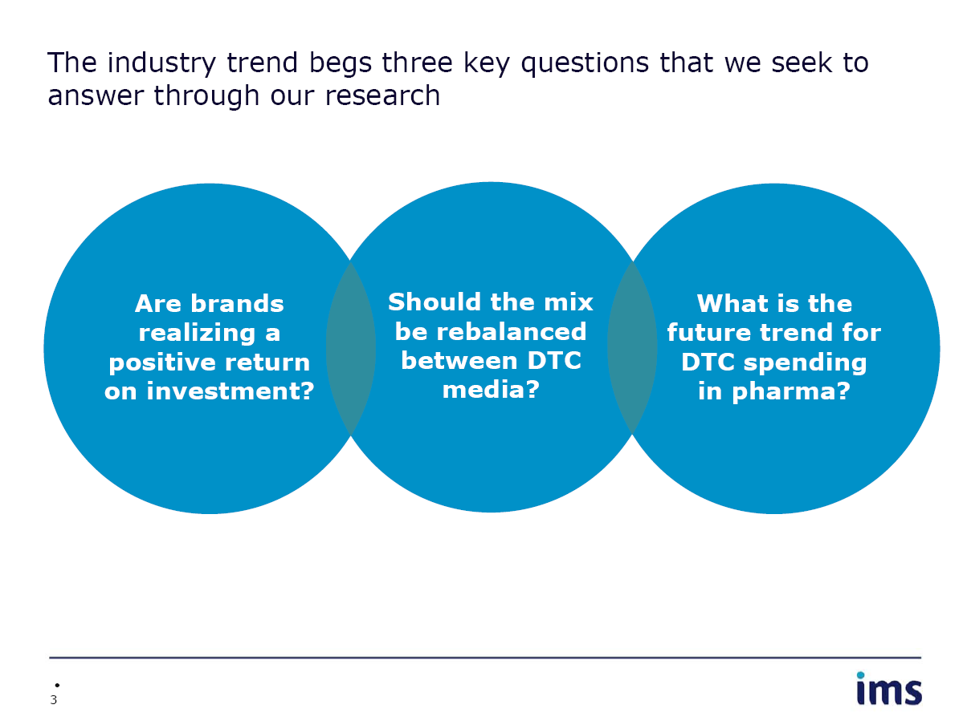
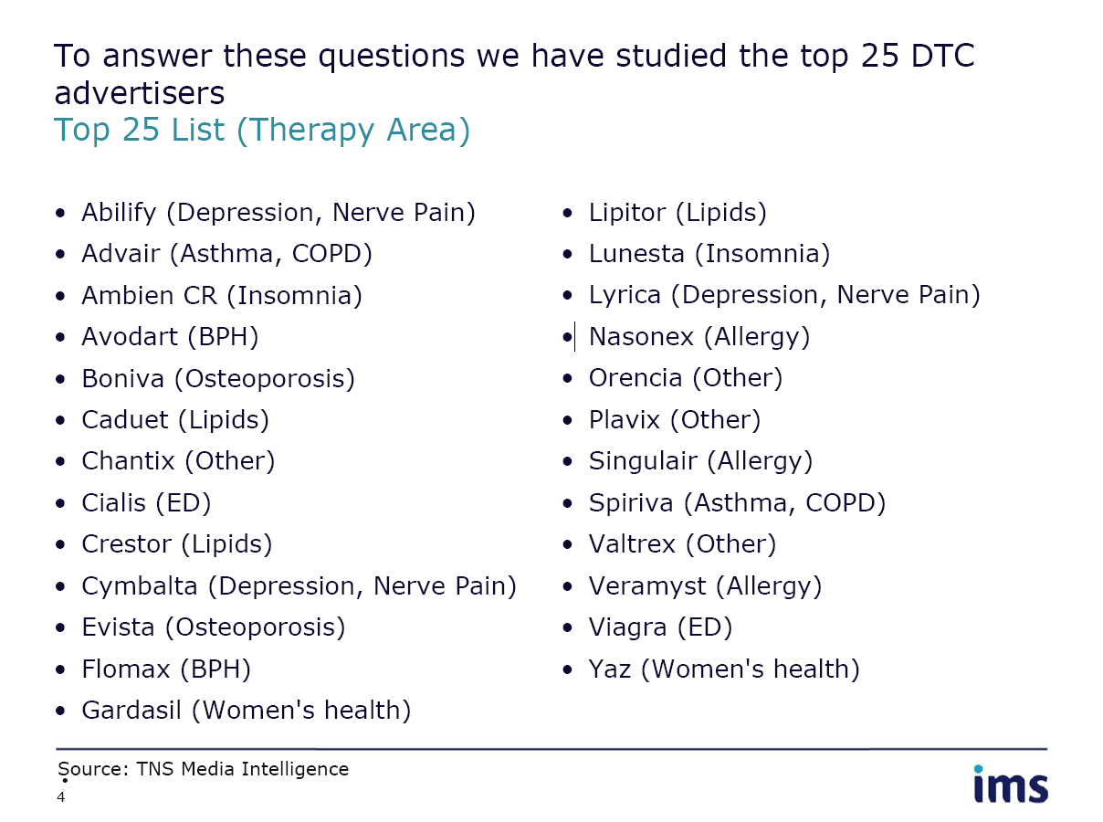
Industry Benchmarks...
...are available for the top 25 pharmaceutical advertisers in 2008, including multi-billion dollar brands.

Slide 36
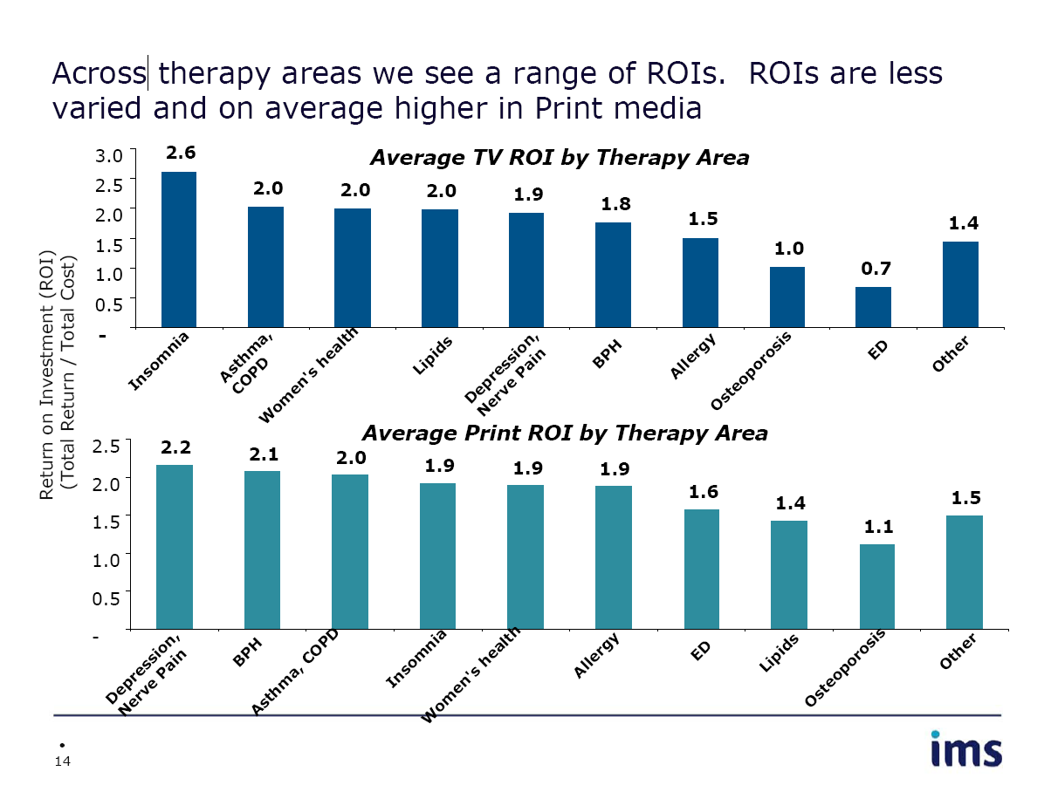
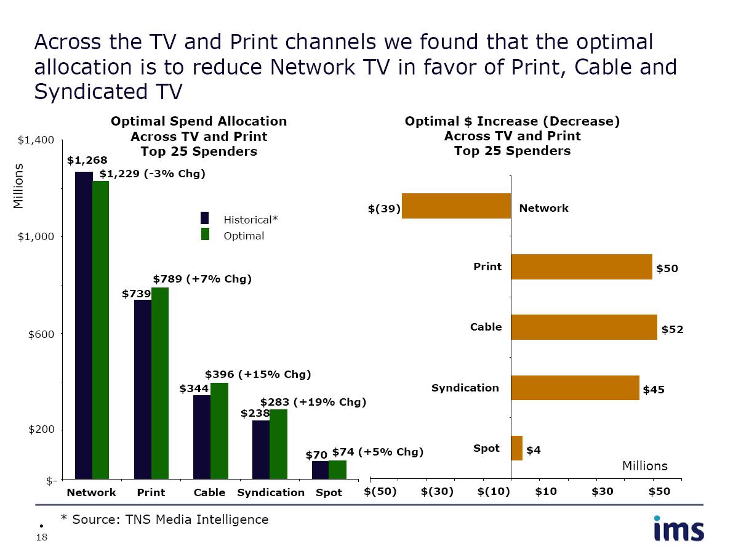
Industry Benchmarks...
...for the top 25 Rx 2008 DTC campaigns varied from unprofitable to approximately $2.6:$1 for TV.

